Slide 1
Smart Trip Planning
Rajasthan Hackathon 50

Slide 2
Architecture Diagram

Slide 3
Flow Diagram
Start
Plan Trip
Select City
Udaipur
Traveling Tickets
Hotel Booking
Activities
Invalid
Jaipur
Activities
Traveling Tickets
Hotel Booking
Invalid
Jaisalmer
Activities
Traveling Tickets
Hotel Booking
Stop

Slide 4
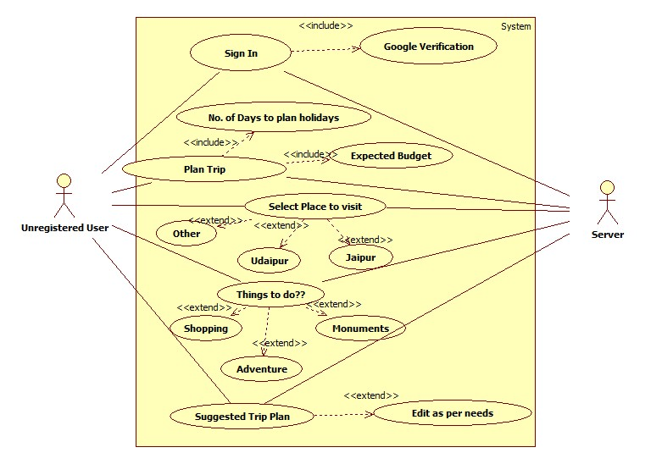
Use Case

Slide 5
